Slide 1



Cloud Computing
How to use cloud technologies for business

Slide 2
Joanna Wake
Wifi
Toilets
Fire alarm

Slide 3
WHAT WE WILL LEARN
Intro to cloud
Identifying a strategy
Scalability
Cyber security
Examples and case studies
Cost and implications

Slide 4
Introduction to Cloud

Slide 5

What is the cloud?
Information accessed via the web.
Desktop computers, laptops, tablets, mobile devices, TV’s
Notes:
So when talking about the cloud, we’re referring to information shared on the internet, accessed via the web.
Many devices today, including desktop computers, laptops, tablets, mobile and even TVs are connected, in some way, to the cloud.
Let’s take a look at cloud computing specifically...

Slide 6
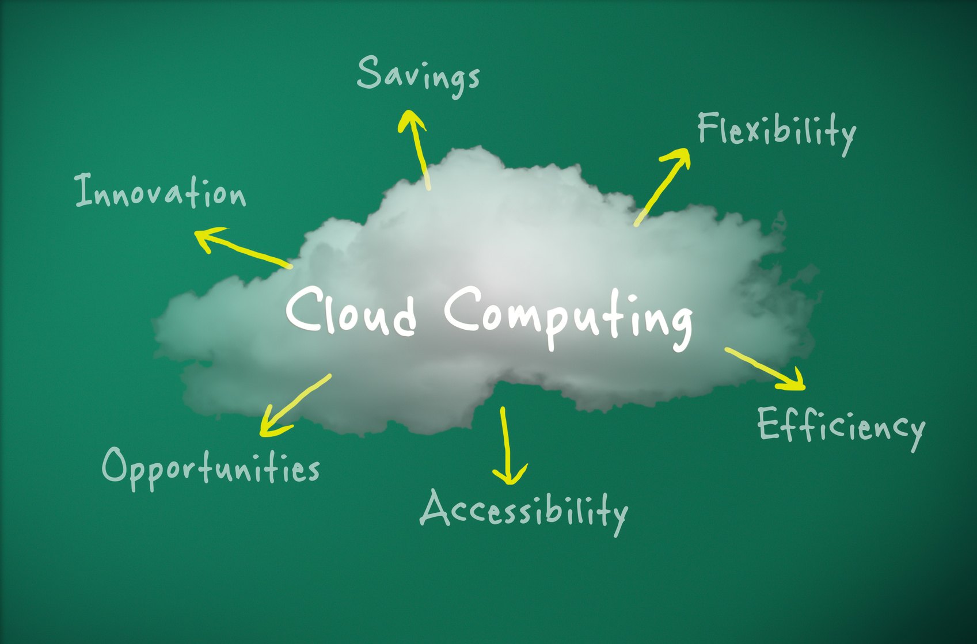
What is cloud computing?
A method of using shared resources hosted elsewhere to deliver a function
email, data storage etc...
The resources of these applications are hosted in the cloud.
Notes:
Ask delegates to identify business functions they think can be cloud based (as discussion) and ask delegates to write at least 5 down on their activity document**
Cloud computing is a method of using shared resources hosted elsewhere to deliver a function. The resources of these applications are hosted elsewhere, in the cloud.
This function could be email, data storage and many more which we will go on to look at in this session...

Slide 7
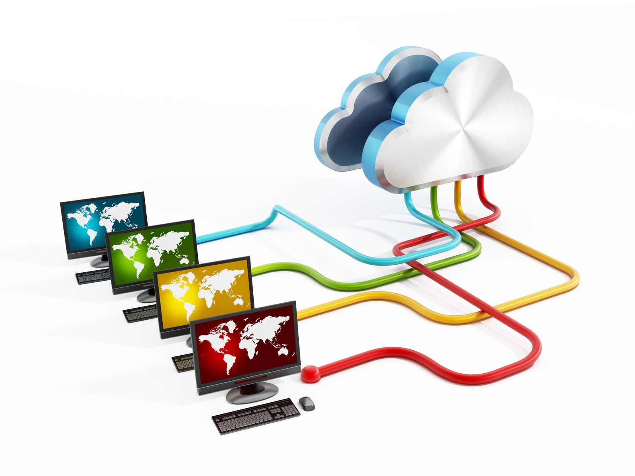
Functionality of cloud computing
Functionality that uses internet based resources
Only the interface dealt with on the client side.
SaaS
Notes:
So cloud computing is simply functionality that uses internet based resources rather than local resources (i.e. in your office) to process, and only the interface needs to be dealt with on the client (that’s you) side.
As software is being delivered as a service, you may hear or see the term SaaS when looking at cloud computing. SaaS refers to ”software as a service” and is used to describe software that is centrally hosted and accessed through a browser.

Slide 8

Who is cloud suitable for?
Long established, large businesses
Start up sole traders
Everyone in between
Notes:
Trainer to put into context the idea of cloud based solutions being available and useful to all sizes of business giving examples of a large traditional company 20 years old, a 5 year old solicitors, and a start up retailer
Certainly construction based companies
Affordability is much higher than the old days of software, whereby it was expensive to buy licences per computer, then pay for updates

Slide 9

Connectivity
Depending on your internet connection Cloud Computing may not be an option (2Mbps + is fine)
Alternatives can be installed, hosted and run from your location
This may be a better if you are in a remote location or do not have access to fast broadband
Notes:
Depending on your internet connection, how fast and reliable it is, Cloud Computing may not be an option for you. In this case, there are many options available that can be installed, hosted and run from your location that do not require a constant connection to the internet. This may be a better option if you are in a remote location, or do not have access to a reliable and broadband connection.
Many Cloud services have the ability to keep data stored locally and then synchronize when a connection is available. This may be a good solution for those without a constant connection, or with a slow connection. However, it will have a negative impact on the collaborative functionality we’ve already discussed.
A speed of 2Mbps upwards should be more than enough to successfully use cloud based apps.

Slide 10

Cloud Computing
The Benefits
Notes:
So now we have identified exactly what cloud computing is, let’s put it in the context of business by specifically exploring the benefits associated with using cloud based platforms.

Slide 11

Leveraging resources
Lots of applications that businesses need to operate.
Often very expensive to run
Logistical requirements
Shared office - Shared receptionist
Notes:
There are lots of applications that businesses need, to be able to operate. These applications are often very expensive to run for yourself because of the logistical requirements to install and support them within your business.
Think about being in a shared office building, you don’t pay for your own receptionist, there’s one shared by the building. This is a similar approach to what cloud computing means to your business and its technology.
Instead of needing to buy, install, maintain and run servers and associated hardware on site, and employing technical staff to look after the hardware, ‘Cloud Computing’ makes this all unnecessary, as all of the above is off site hosted by the service provider, and the technical support from online platforms tends to be very responsive, and excellent.
On site all you will need to worry about is having access to broadband and supplying desktop computers / laptops in order to access the internet.

Slide 12
Integration
Combining cloud based platforms
Cloud based platforms allow sharing of information
e.g CRM solution sharing contact information with Email platform
Task 2
Notes:
ask delegates to identify & discuss opportunities for integration between cloud based platforms (specifically those identified in task 1)
ask delegates to note down an example in Task 2 of the activity document.
relate examples back to their own business context.
Cloud based platforms allow for the sharing and integration of information between related platforms, for example cloud based CRM platforms may support the integration of contact information from within your cloud based email platform, or a cloud based payment platform like Paypal may integrate with your cloud based invoicing platform like Hiveage.

Slide 13

Cost Savings?
No / nominal start up costs
No server to buy or maintain
No manual installation
No IT staff
No maintenance
Notes:
Start up costs (presuming you already own a device capable of connecting to the internet) when adopting cloud based applications may be nil or nominal when compared to traditional hardware and software solutions. There’s no server to worry about, no software to manually instal and update, and no IT staff needed to install or maintain it.
SMEs are often not in a position to recruit large teams to which workload can be delegated. The use of cloud technologies present a significant advantage due to their widely accessible, and extremely secure features.
Cloud based applications grow along with the size of the businesses using them, with most having tiered plan levels starting at free, then a monthly subscription tier with additional features, then a third premium monthly subscription tier with unlimited features.

Slide 14
Scalability

Slide 15
Scalability
Services that grow as you grow
Infinitely scalable (up or down)
Changing requirements
Usage based pricing
Cost transparency
High performance resources, no upfront investment
Long term shrinkage of cost

Slide 16
Cutting edge
Software update? Refresh your browser!
Cutting edge
No manual updates
Competitive industry
Fast moving technology
Pushing boundaries
Notes:
As businesses simply access cloud based platforms via their web browser, they will always have access to the most cutting edge version of the software. There is no lengthy download and install process to update software, it is as simple as refreshing your web browser!
Also, cloud computing is a competitive industry, with some of technology’s biggest names providing cloud based platforms and vying for widespread consumer use. This means that cloud computing will continue to push boundaries in terms of the technology on offer and also from a pricing perspective.

Slide 17
Alternatives to public cloud storage
External hard drive
Private Cloud
Virtual Private Networks (VPN)
Notes:
A business may not want, or be able, to use ‘The Cloud’. It’s important to be aware of the alternatives - these may use similar technology, but in a different way. Although ‘The Cloud’ isn’t open in a security sense, additional options could be used to further protect businesses, or mitigate issues around the use of Cloud technologies.
External hard drives are often a popular option for storage. They’re relatively cheap, easily available and usually portable. Although the type of drives you can buy from your preferred retailer are pretty robust these days, there’s a real chance that the drive will fail at some point. Reducing the risk by using a secondary external drive is a good option, ideally keeping it off site to avoid any environmental issues.
Private Cloud technology is much more commonly available these days than previously. These storage devices can be remotely accessed using private access (rather than a ‘publicly’ available website) but affords the same functionality to using Cloud storage. The Private Cloud device will need to be kept in a location with sufficient internet access to be useful.
VPNs allow the accessing of networked resources from a remote location. Allowing a fuller experience than simply just storage, networked resources like printers and other computers can be accessed from an encrypted (secure) connection. Setting up a VPN is a great solution for businesses which need employees to log in remotely that want that additional layer of security, or where policy prohibits resources to be ‘public’ facing.

Slide 18
What is ERP?
“Enterprise resource planning, or ERP, is software that allows a business to use a system of integrated applications to manage, and automate, many back office functions related to technology, services and human resources.”
Notes:
**Note trainer : Some businesses may have heard of SAP, which is a common example of ERP. NetSuite is another example of software that can combine databases into one central point that allows you to see CRM data, eCommerce data and back office data in one place - it’s aimed more at larger businesses, but is useful for learners to be aware of options at this stage - to help prepare them for growth and scalability.
Trainer to briefly define ERP, but not dwell on the subject too long

Slide 19
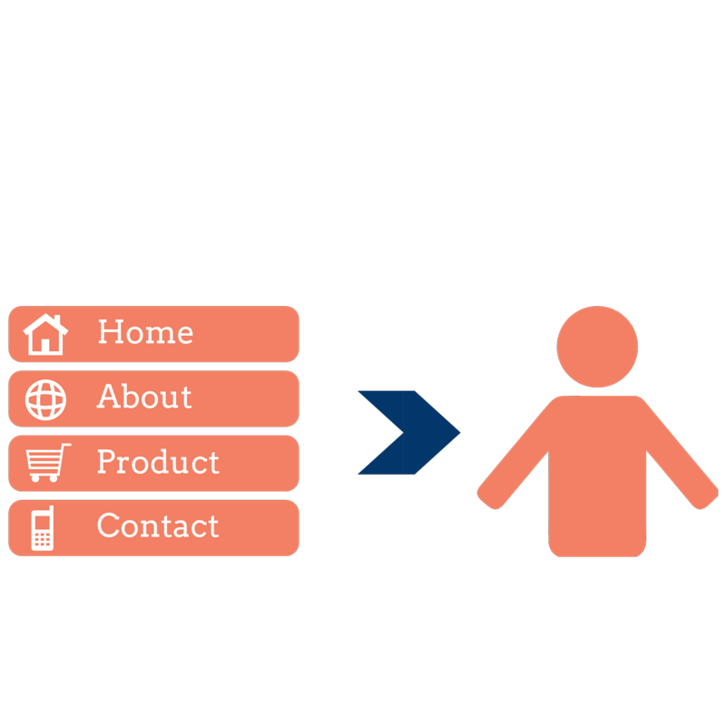
What does the future look like?
Notes:
As businesses embrace back office solutions, further integrations are available. API (Application program interface) integration works as a bridge between two systems - allowing one to talk to other. An example of this could be to refocus contact forms that you have on your website to be driven directly into your CRM tool instead. This can help to save time by removing the step of manually adding entries. If a business is also using pipeline functionality (to track sales and opportunities) in a CRM, they can operate more efficiently by linking these two widely used services together.
Alternative example -
A business may have a contact form asking people to sign up to their newsletter (or similar email subscription), instead of this form flowing through as an email which then needs to be manually entered into a service like MailChimp - a MailChimp sign up form can be embedded into the website to remove the manually element - thus improving effiency.

Slide 20

Security

Slide 21
Security
https:// - secure connection
Secure connections used for websites exchanging sensitive data
Strong passwords
Notes:
Whenever you’re passing any information over the internet (i.e. entering it into a webpage), you should always check that the server you’re connected to is secure.
You can do this by checking in the address bar (usually located at the top of your browser) and check to see if the address starts “https”.
https is a secure method of communicating with a website. It is not available for every website, but should be available (and used) for websites that are used to communicate personal information. A popular example of this is ecommerce (online shopping). You often enter debit or credit card information into these sites, along with your address details; this information should be kept secure, which having a secure server (https) ensures.
When using cloud applications, it is often the same process. Whether sensitive information is being transmitted, the connection should be secure. That way, you can be confident that your data is secure and no unauthorised 3rd party can access it using that connection.
Commonly, the way to access a cloud application is using a username and password combination. Ensuring that your password is ‘strong’ (a term used to describe a password that contains a combination of letters, numbers and special characters that makes is more difficult to guess) is good practise to ensure your data remains safe.
Examples of bad passwords may contain the word password (i.e. password1, password1234), or personal information about you (i.e. if your name was Simon, using the password “simon72”)
‘Strong’ passwords should be much harder to guess (though this makes them harder to remember too). A password like “Byk^iw97jY3O” contains capital letters, numbers and special characters, but is very difficult to remember.

Slide 22
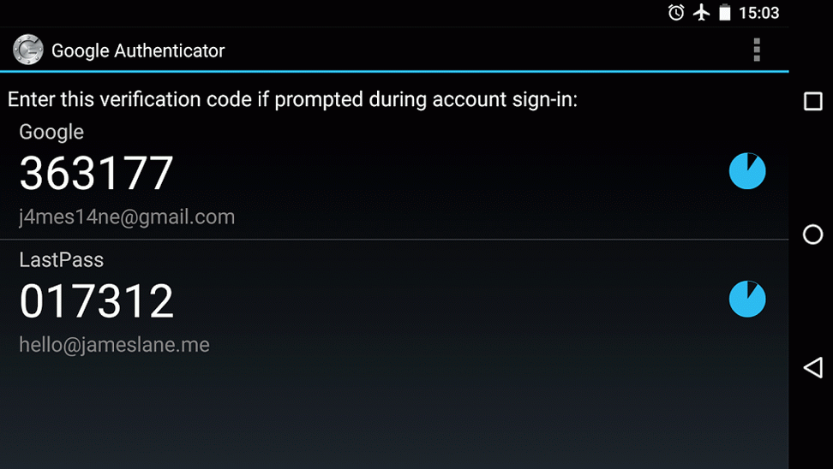
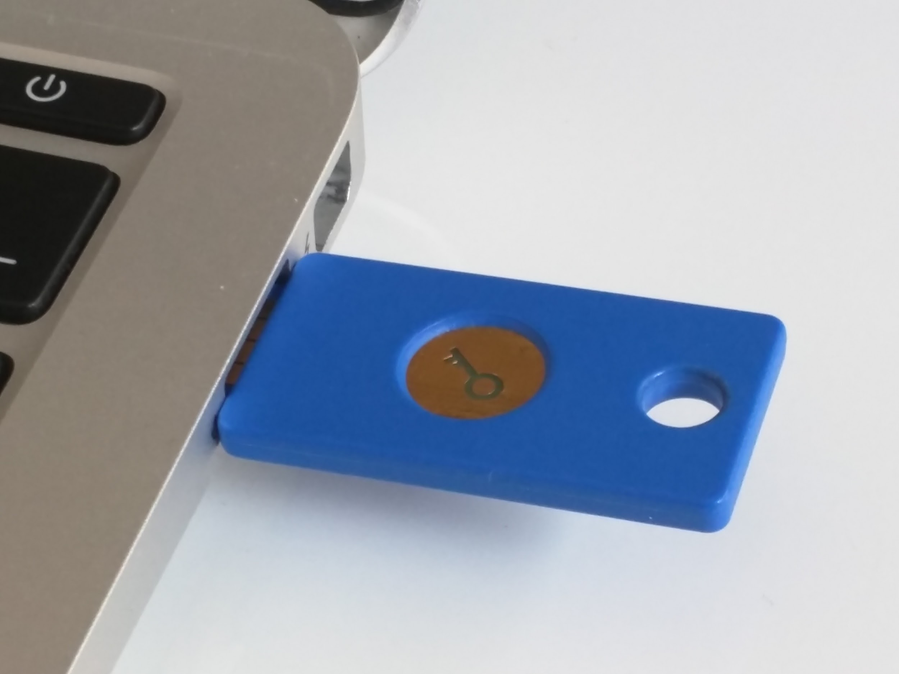
2-Step Verification
Secure login
Used by most cloud based applications
2 steps - username and password then using another device
22
Notes:
2-step verification usually combines something you HAVE with something you KNOW - Like a dongle and a password.
Many cloud based applications employ some form of 2-step verification.
2-step verification is a two stage login process.
You enter your username and password into the cloud application
Your retrieve a code from the mobile device you have registered with the application
Without the correct username and password combination AND the code from the mobile device, your application can not be accessed. So even if someone had managed to discover your password without your knowledge, without your mobile device, they won’t be able to login.
2-step verification is available on an increasing number of cloud applications and can dramatically increase the security of your account and therefore the data held within it.

Slide 23
Are you protecting yourself?
‘Digital estate’
Not just your online accounts
Do you have business information on your mobile device?
How is your mobile/laptop/desktop computer secured?
Laptop/desktop password secures your profile, not your data
Hard drive
Notes:
Mobile devices are ubiquitous these days, and you can use your device to manage your business as it’s with your wherever you are, whether that is a mobile phone, tablet or any other portable device capable of connecting to the internet and receiving data.
Ensuring that your data is synced to your device is essential. Depending on the type of account you have, and what type of service, you may be able to add either a dedicated mobile app (check the appropriate App Store, Play Store or Windows Store) or configure your mobile device to work with an existing service.

Slide 24
Back office & Data Protection
Data Protection Act 1998
Terms & conditions
Sensitive data
Principles 7 & 8 of Data Protection Act
Information Commissioner's Office
https://ico.org.uk/media/for-organisations/documents/1540/cloud_computing_guidance_for_organisations.pdf
Do the benefits far outweigh any risk?
Notes:
Before entrusting your data to a cloud provider you need to have a very close read of their terms and conditions
The Data Protection Act is based on eight legally-binding Principles. Of these two are particularly relevant to cloud computing:
Principle 7, which says you must have appropriate security
Principle 8, which controls transfers of data abroad
SECURITY:Cloud providers typically stress the degree to which they take security seriously, and it is often claimed that their security is likely to be considerably tighter than in most small organisations. This is probably true, but cloud providers are also a more tempting target, and breaches undoubtedly do occur.
You must, therefore, undertake due diligence in assessing their security undertakings.
DATA STORED ABROAD: Under Principle 8, transfers of data outside the European Economic Area are allowed if:
the jurisdiction it is going to has an acceptable law; or
the recipient in the USA is signed up to Safe Harbor;
You may never be able to mitigate all risk, but by doing a risk assessment on each platform you will be able to decide how likely any risk is in comparison to the benefits of each platform.

Slide 25
Questions around your data
Who owns your data?
How easy it is to move away from a service?
Notes:
When choosing a service that will hold your/your customers’ data, it’s important to perform due dilligance to make sure that should you need to leave that service, you can do so easily.
For example, if you invest time and money into a CRM with which to store your client information database, but decide to move to a different CRM, you will want an option to export your data, and that the data stored in the database remains yours.
These are questions you can ask the prospective provider to ensure that you’re protected further down the line of developing your business.

Slide 26
Do you backup your data?
Think about keeping your data safe....
Do you backup to an external hard drive?
Where do you keep your backups?
Have you tested your backups?
Notes:
This is an opportunity to have the learners think about whether, and if so, how they’re backing up their data and files.
Some insurance policies may require backups to be separately stored in a fireproof safe, where some may require a copy to be kept off site. This is something that learners should check on their existing policies to ensure they’re protected.
Backing up to ‘The Cloud’ may be an option for businesses too.
This is a great opportunity to talk to businesses about the importance of testing the backup. Verifying not only that the backup is taking place in the first place, but that it’s working and capturing all the data needed. In the same way that we may perform fire drills to ensure that our procedures are robust, we must also test our data and disaster recovery options.

Slide 27
Real-world examples

Slide 28

Let’s apply this to your business
Real-world Business Examples
Notes:
So now we have introduced the theory behind cloud technology and look at the general benefits from a business standpoint, let’s look at some real world examples in terms of platforms you could utilise within your business that handle such things as email marketing, CRM, data storage, productivity, invoice creation and more.
In this session we will not be running through HOW to use each platform, but we will be comparing the benefits of using each cloud based platform with more traditional solutions.

Slide 29
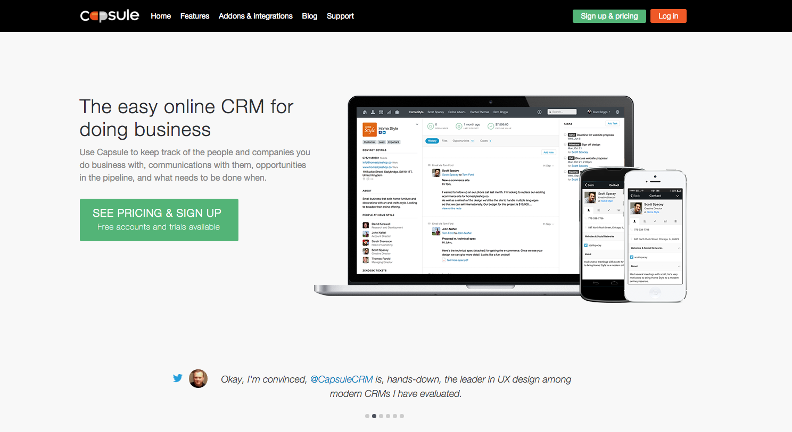

Slide 30


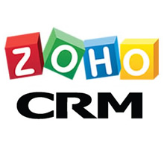

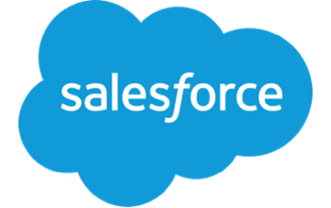

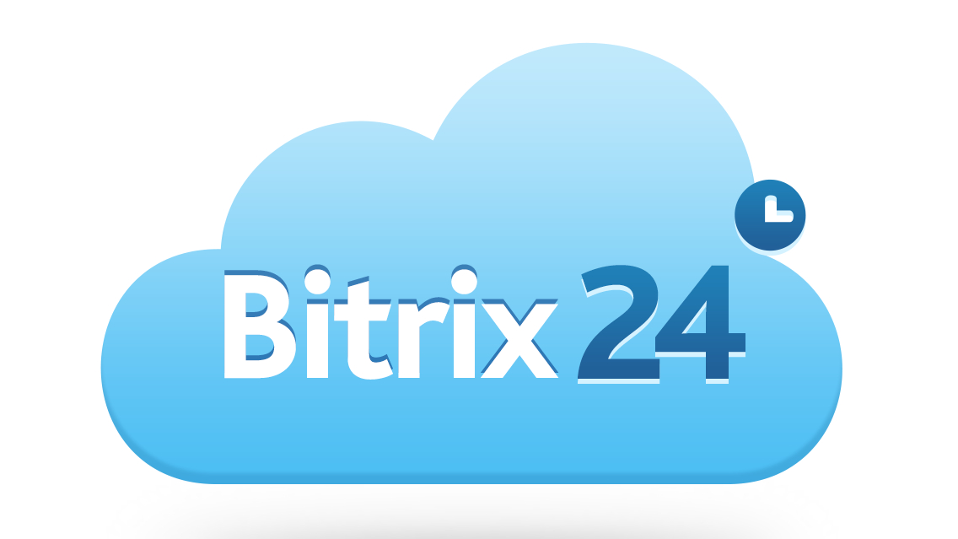
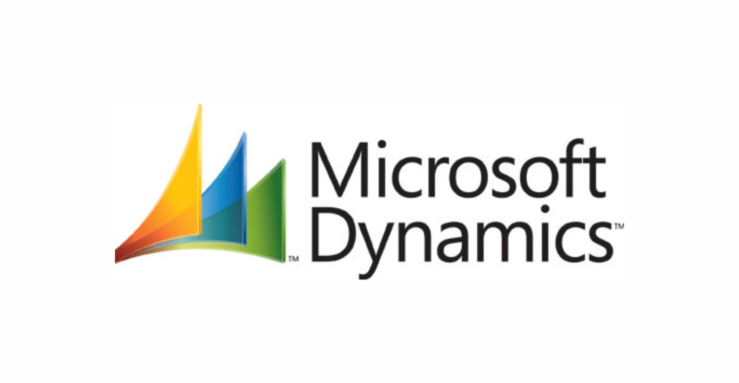
Notes:
Alternative CRM systems

Slide 31
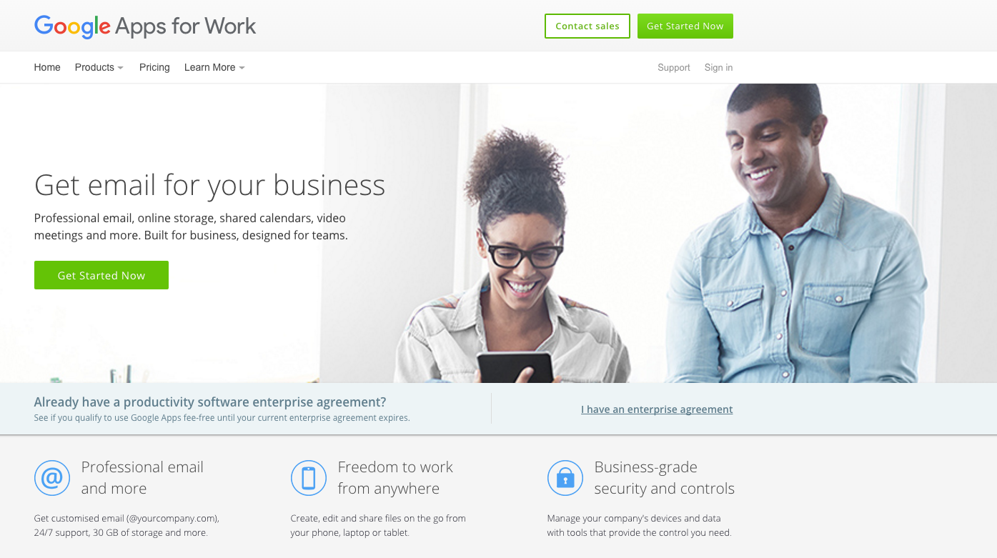
Cloud based productivity
Notes:
https://apps.google.com/
Google Apps is a cloud based office management suite. Providing tools including email, word processing, spreadsheets, presentations, video conferencing and enterprise social networking (and more), using a leveraged resource allows the features that would normally require robust, expensive, dedicated equipment, to be provided at a far reduced cost. Many new start businesses use other email addresses (@yahoo.com, @hotmail.com or @btinternet.com etc.) when setting up their business communication as the expectation that having a ‘you@yourname.com’ email address is too difficult or costly. Google Apps allows the simple creation of a product that works around your domain name (that you may have purchased for your website - yourname.co.uk for example), email addresses are then created as needed which means that whether a business has one person, or 10,000 - Google Apps is a scalable solution that will grow with the business, but avoid the upfront costs of server equipment.
Also, using a cloud based solution allows for integrations to exist between other systems - as we’ve already discussed with CRM solutions like Capsule.
With Google Apps, you are able to work smoothly between different devices whether desktop, laptop, mobile or tablet - and open Microsoft Office documents (Microsoft Word, Excel and PowerPoint) and save your work in the Microsoft Office format (and more) to ensure that you’re able to work with people using alternative systems.

Slide 32
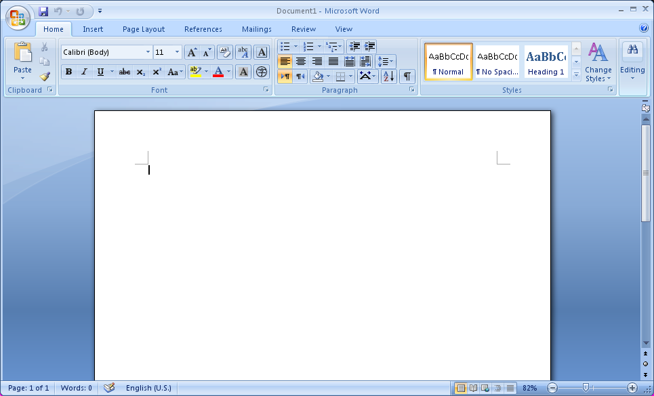
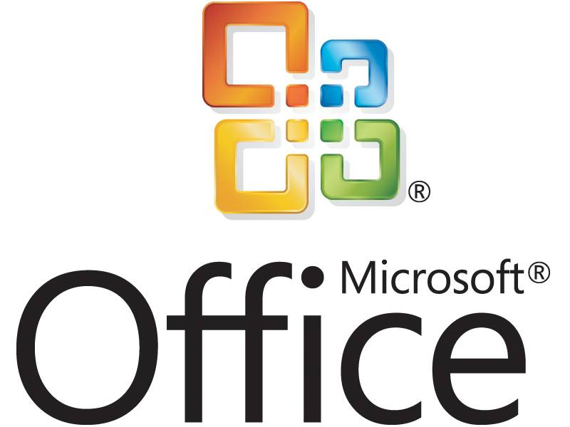
Notes:
Microsoft Office is a widely used, familiar service that is able to be installed onto different types of devices and used offline. It includes Microsoft Word (word processing), Excel (spreadsheets), PowerPoint (presentation) and OneNote (note taking). Different version of MS Office can contain additional components including Outlook (email), Publisher (desktop publishing), Access (database) and Skype (VoIP and video conferencing).
Note that some functionality already introduced at this point (shared calendar for example) require additional requirements.

Slide 33
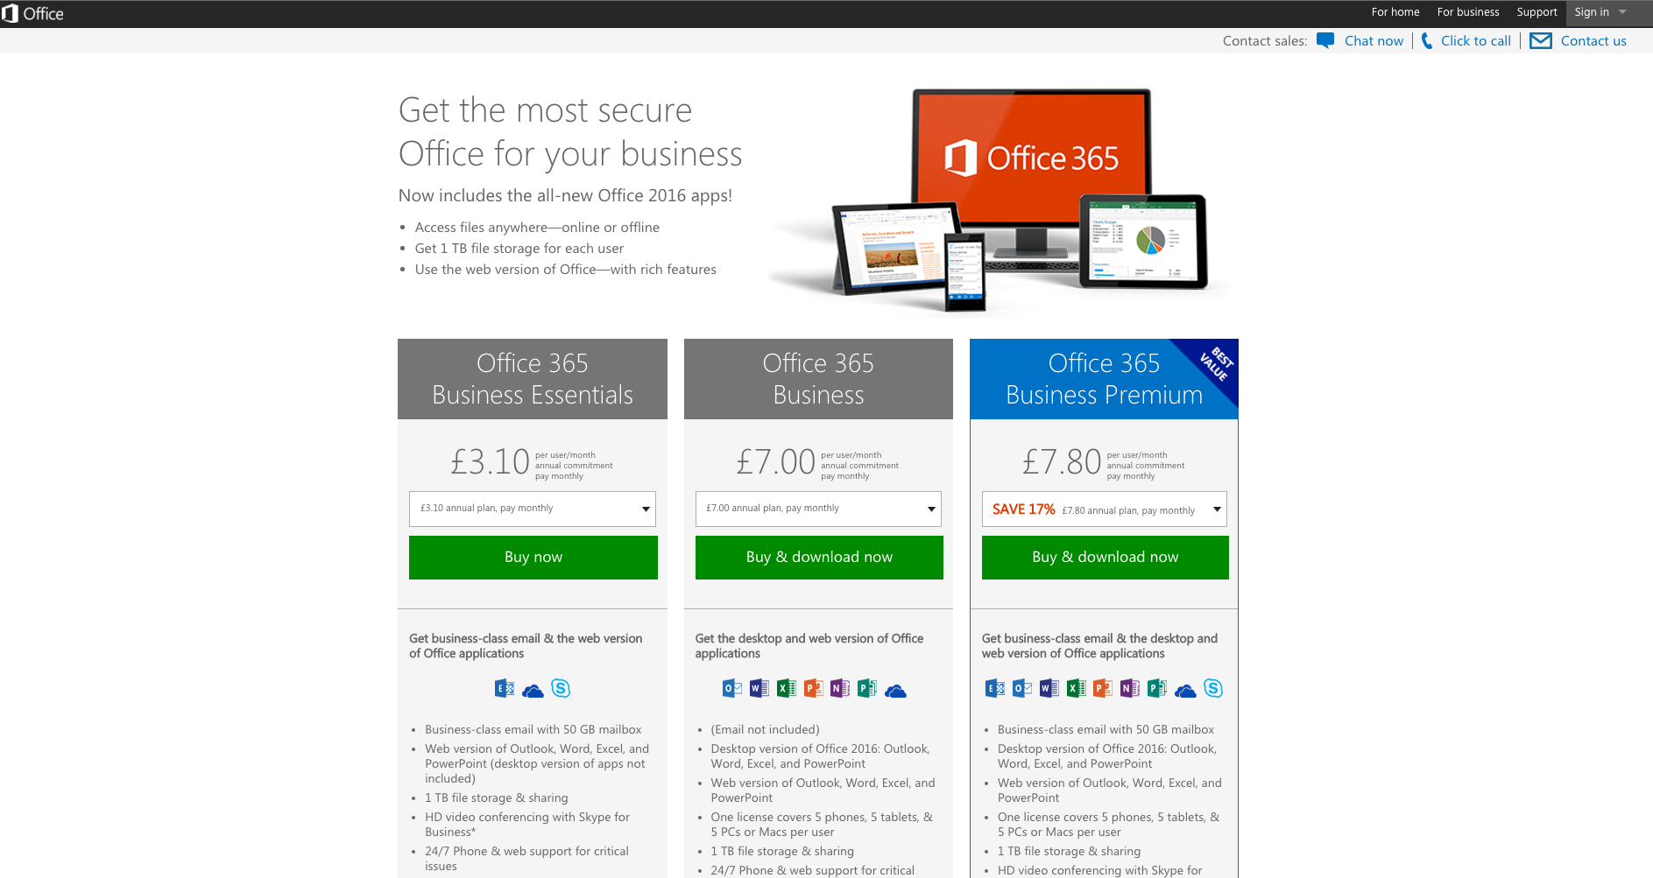
Notes:
https://login.microsoftonline.com/
Familiar programmes (word, outlook, excel, powerpoint etc) but cloud based as a subscription service.
Workforce highly likely to be familiar with products.

Slide 34
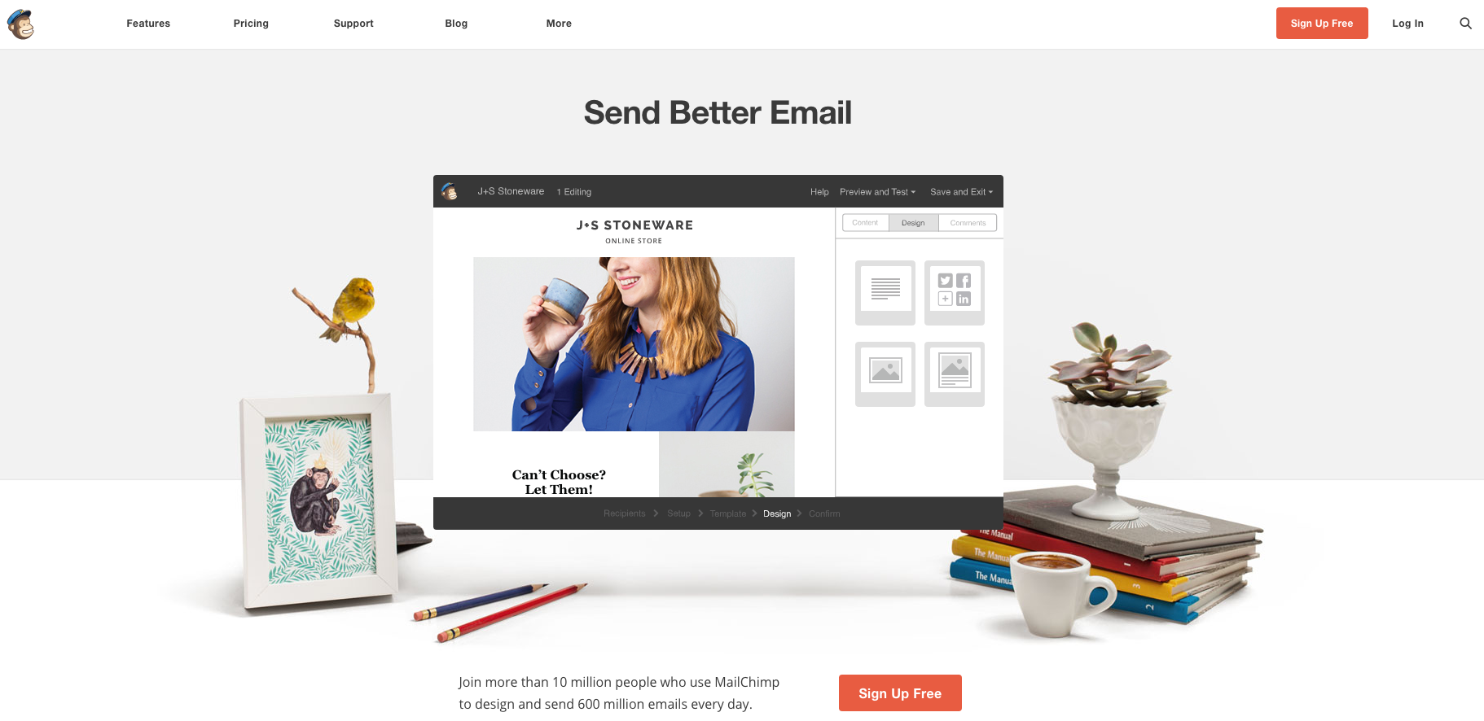
Notes:
www.mailchimp.com
The interface is simple and customizable
MailChimp has a familiar aesthetic and a simple user experience, offering the user many options for making email campaigns bespoke.
If you have less than 2,000 email subscribers, you can use MailChimp's most basic plan for free.
MailChimp also provides thorough analytics that allow you to see how many subscribers have opened your email, which links were clicked most frequently, how many people unsubscribed after receiving your email, and how your response compares to the industry average.
MailChimp lets your readers share your newsletter with their Social Media followers with one click, reflecting its deep social media integration.
MailChimp integrates with mailing list sign up platforms like Squarespace forms, which is extremely helpful when you're capturing emails from those signing up to your newsletter and mailing list. Each time someone new subscribes to to your list / newsletter their information is automatically uploaded into your specified mailing list on MailChimp. Each Sunday I log in to my account, select the list, create the email, and click send without any importing on my end. Whether you are putting together an event on EventBrite, a survey on SurveyGizmo or want to see Google Analytics reports from your email surveys MailChimp will integrate with those services.

Slide 35





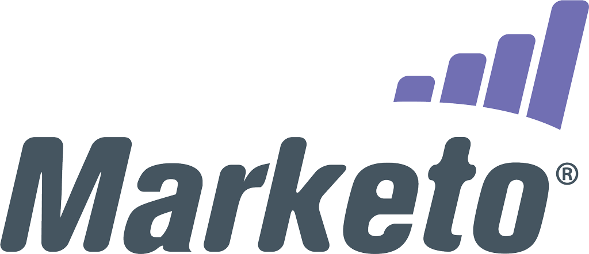
Alternatives to Mailchimp

Slide 36
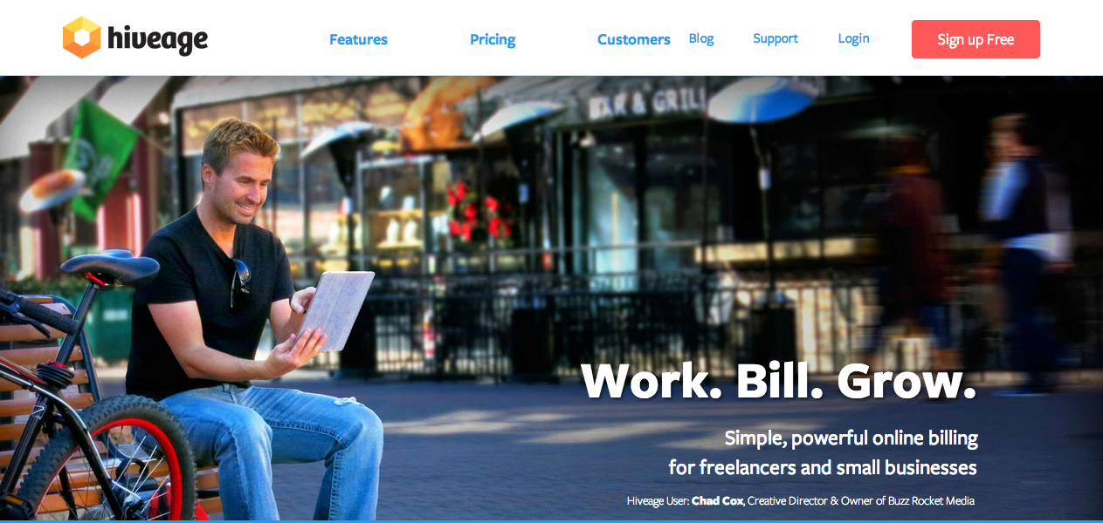
Hiveage: Cloud based invoicing
Notes:
https://www.hiveage.com/
With Hiveage, you can send invoices and estimates, get paid online and manage multiple teams and businesses, all from within a single account.
Aimed at small businesses who may need to access their invoicing application on the go, Hiveage allows you to create invoices from your computer wherever you are.
Because Hiveage is a cloud based application, it can integrate with online payment services (like PayPal for example). This may help your business collect payment by giving your clients additional ways to pay.
Hiveage is free to sign up, and is built on modular components so you can add the functionality that you want, paying for the only the enhancements that you need.
HOW CAN IT HELP?Many small businesses don’t have the funding to support multiple support staff, so each member of the business must be responsible for updating their records.
When it comes to invoicing, being able to retain accurate records and getting those invoices sent on time can make all the difference to your cash flow, the lifeblood of your business. With a cloud based invoicing tool, you can update your invoice with travel, or hourly blocks as and when they happen, instead of waiting until you’re back in the office.
This can mean more reliable invoicing, and faster too.

Slide 37
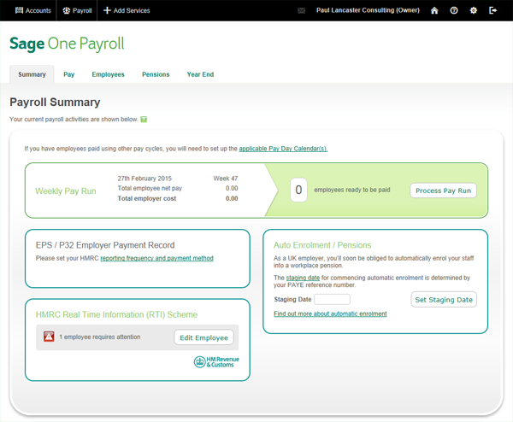
Notes:
Sage is a very popular provider of accountancy and invoicing tools. Some of which are available online and on mobile devices, and some of which are installable onto desktops. Integration into the HMRC RTI (real time information) may prove very useful for businesses that have PAYE employees. More information on the Sage range of tools and software is available at http://www.sage.co.uk/
HOW CAN IT HELP? Having the support of experienced developers and accountancy experts can help guide companies, keeping them running efficiently and avoiding mistakes.

Slide 38
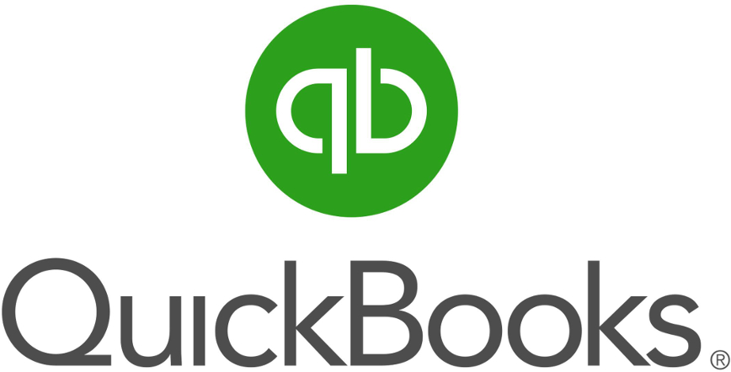

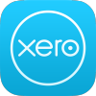


Alternatives

Slide 39
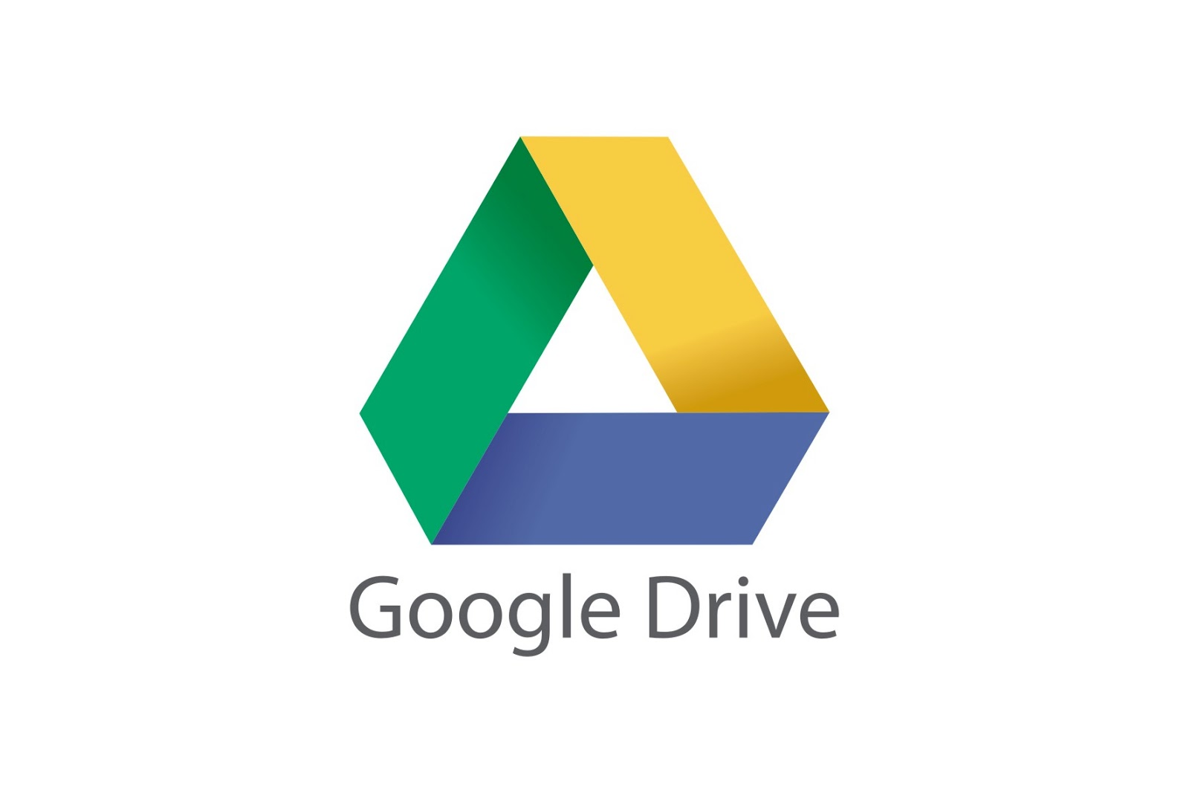
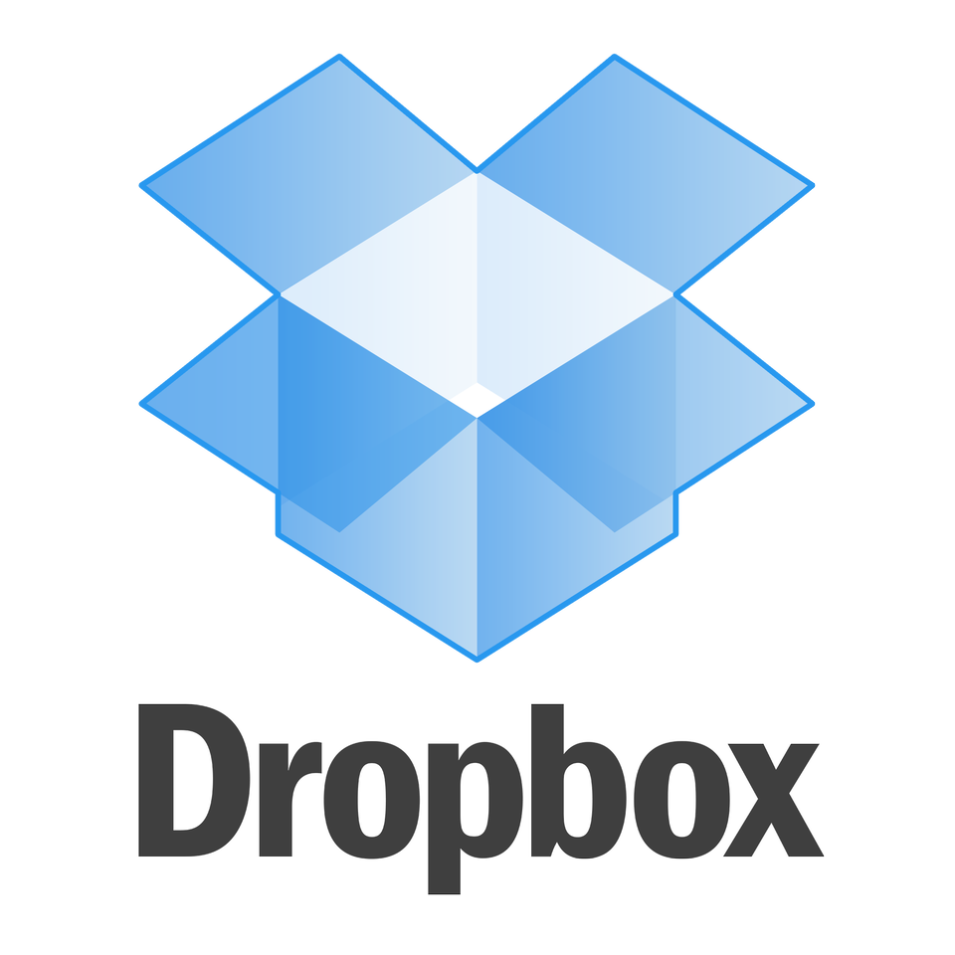
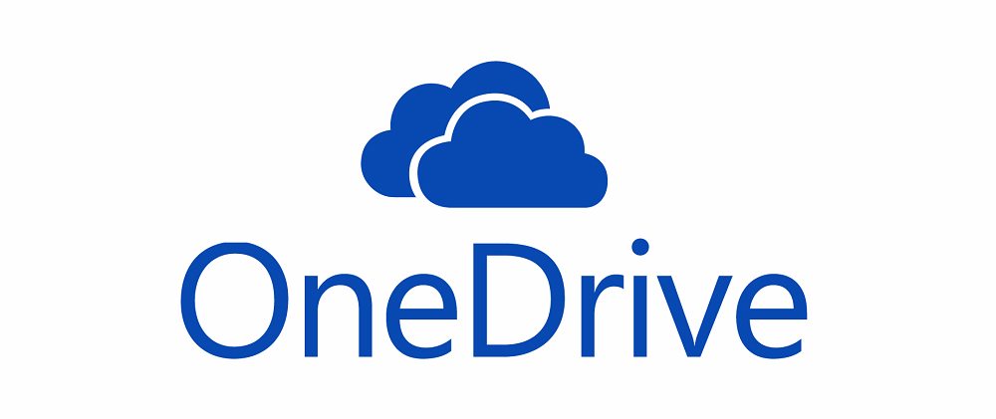
Storage
Notes:
For storage options, whether for backup or for easily sharing files between coworkers, colleagues, collaborators or clients, there are a few options. One of the well known options is Dropbox - files can be synchronized to the Cloud from the users’ desktop and then replicated on other users’ desktops (or access via the website).

Slide 40
Cost

Slide 41
Cost Savings?
No / nominal start up costs
No server to buy or maintain
No manual installation
No IT staff
No maintenance
Notes:
Start up costs (presuming you already own a device capable of connecting to the internet) when adopting cloud based applications may be nil or nominal when compared to traditional hardware and software solutions. There’s no server to worry about, no software to manually instal and update, and no IT staff needed to install or maintain it.
SMEs are often not in a position to recruit large teams to which workload can be delegated. The use of cloud technologies present a significant advantage due to their widely accessible, and extremely secure features.
Cloud based applications grow along with the size of the businesses using them, with most having tiered plan levels starting at free, then a monthly subscription tier with additional features, then a third premium monthly subscription tier with unlimited features.

Slide 42
Cost Savings?
Solution | Cost
In house exchange server, first year cost excluding user licensing | £6500 approx.
Google Apps (Cloud) | £33 per year per user
Microsoft 365 (Cloud) | £37.20 per year per user

Slide 43

Access anywhere
Flexible working incl on mobile
Working on the road
Multi devices
Strategic advantage
Mobile support
Notes:
Cloud based platforms can be accessed from literally anywhere, providing you have internet access. This offers massive benefits in terms of flexible working and for those members of staff who may work on the road. By not being tied to only devices owned by your organisation, or having to access solutions on your company premises, the opportunity to work anywhere offers strategic advantage.
Also, most cloud based services offer some if not full mobile support, meaning you can access the platform from tablets and mobile phones, again from anywhere (providing you have connectivity).

Slide 44

Collaborative Working
Real-time collaboration
Different offices
Different cities
Different countries
Different continents
Same document, real time…..
Notes:
Cloud technology allows you to have people in different offices, different cities, different countries or different continents, all working on the same document in real-time.
*Trainer to ask delegates to think how collaborative working will drive efficiency in their business, and answer the question on Task 3 in their activity document.

Slide 45
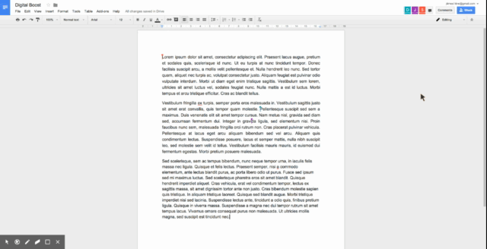
Notes:
This is an example of three people working in the same document at the same time. As you can see, the document viewer (the view that the video is shot from) sees the identity of the other two participants in order to be able to visually note what each action is taken.
This animation has been included here to avoid the need for connectivity, but it can alternatively be loaded via YouTube at https://www.youtube.com/watch?v=TwGtYmAdLTU (or by clicking on the image itself)

Slide 46
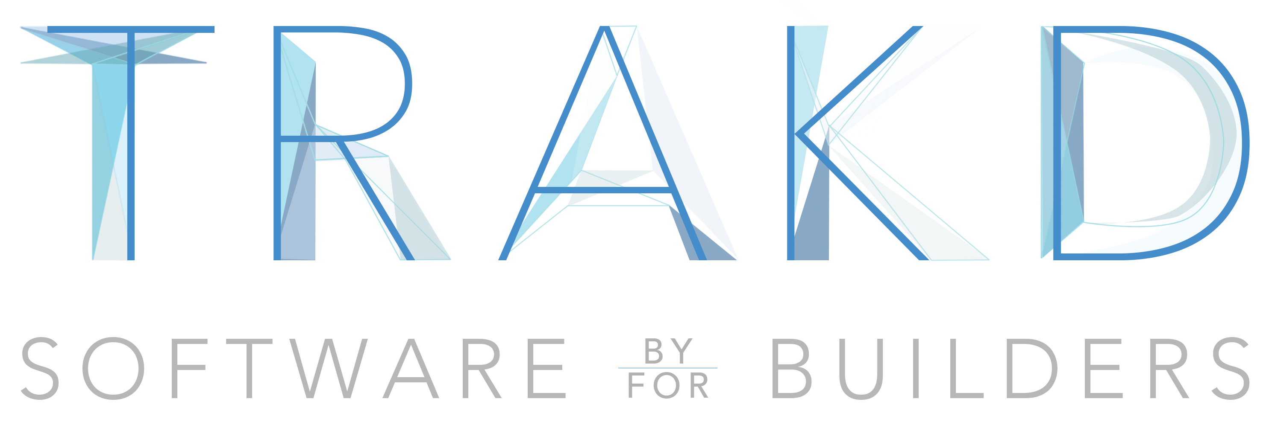
Notes:
[insert slides on TRAKD Demo & Examples]

Slide 47
Implications

Slide 48
Getting data onto your mobile
You can use your device to manage your business wherever you are
Syncing your data to your device is essential
Mobile app (check your App Store, Play Store or Windows Store)
configure your mobile device to work with an existing service
Notes:
Mobile devices are ubiquitous these days, and you can use your device to manage your business as it’s with your wherever you are, whether that is a mobile phone, tablet or any other portable device capable of connecting to the internet and receiving data.
Ensuring that your data is synced to your device is essential. Depending on the type of account you have, and what type of service, you may be able to add either a dedicated mobile app (check the appropriate App Store, Play Store or Windows Store) or configure your mobile device to work with an existing service.

Slide 49
Questions?

